Slide 1
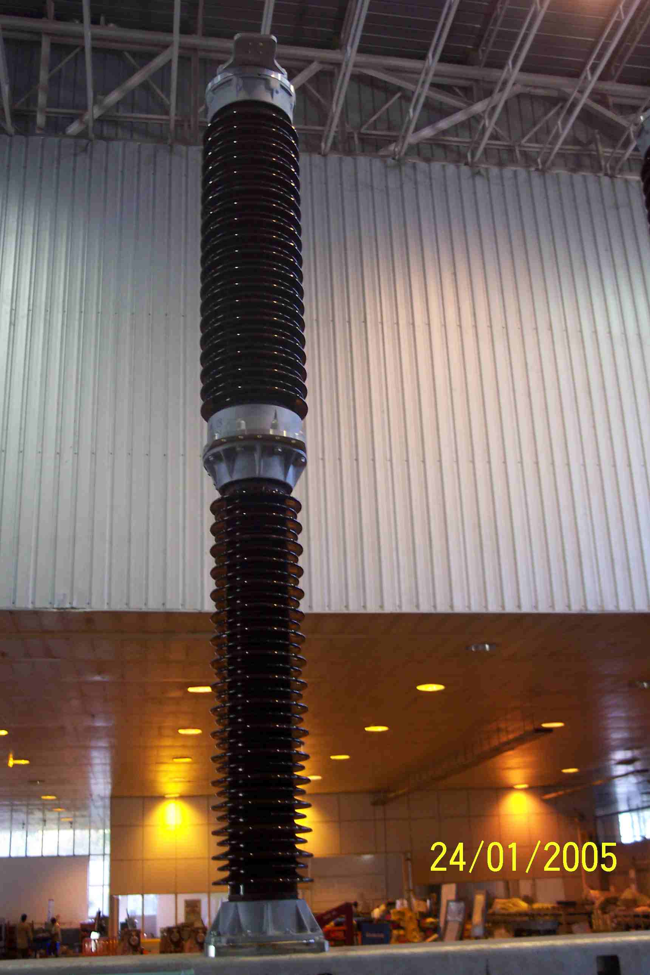
SIEMENS
HVCB SPARES
Complete pole , 145KV, 40KA CB
S4799201001

